Slide 1
Exploration Leads to Discovery and New Understandings

Slide 2
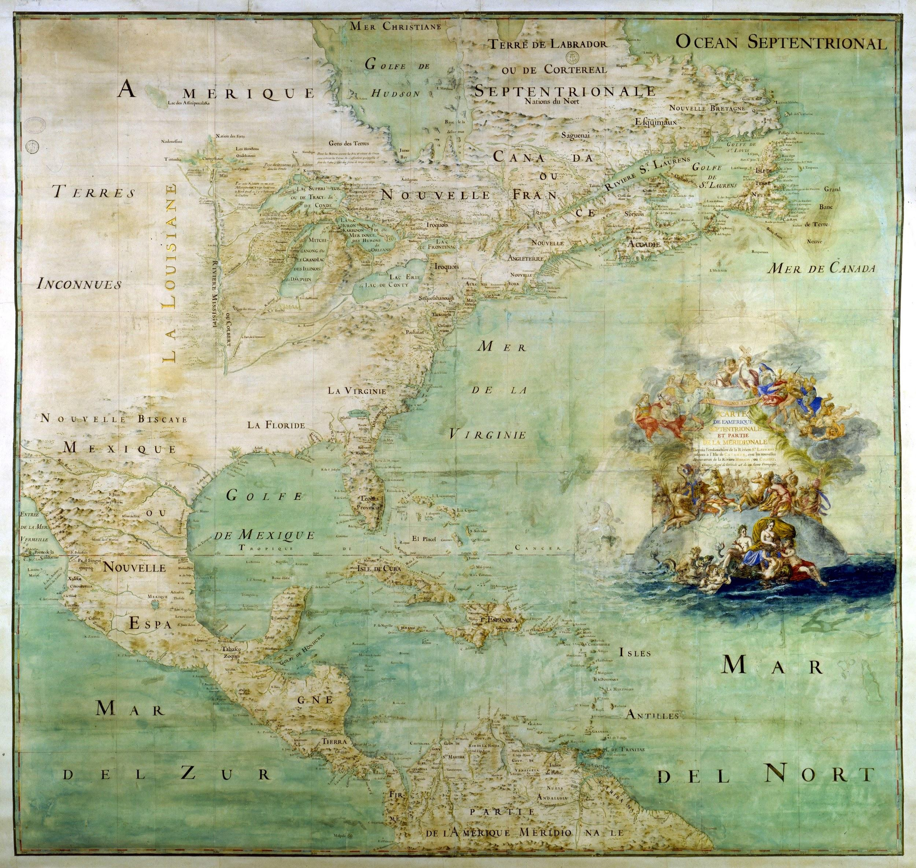
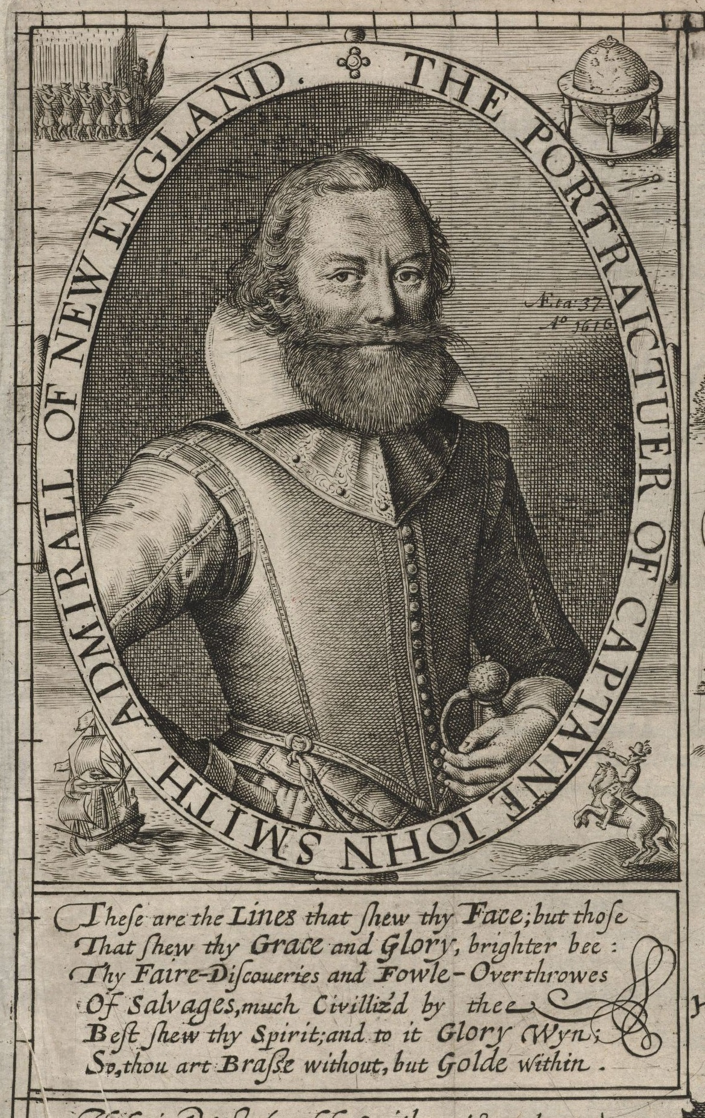
Notes:
roanoke va

Slide 3
What do you notice?
What do you wonder?
What do you think?

Slide 4
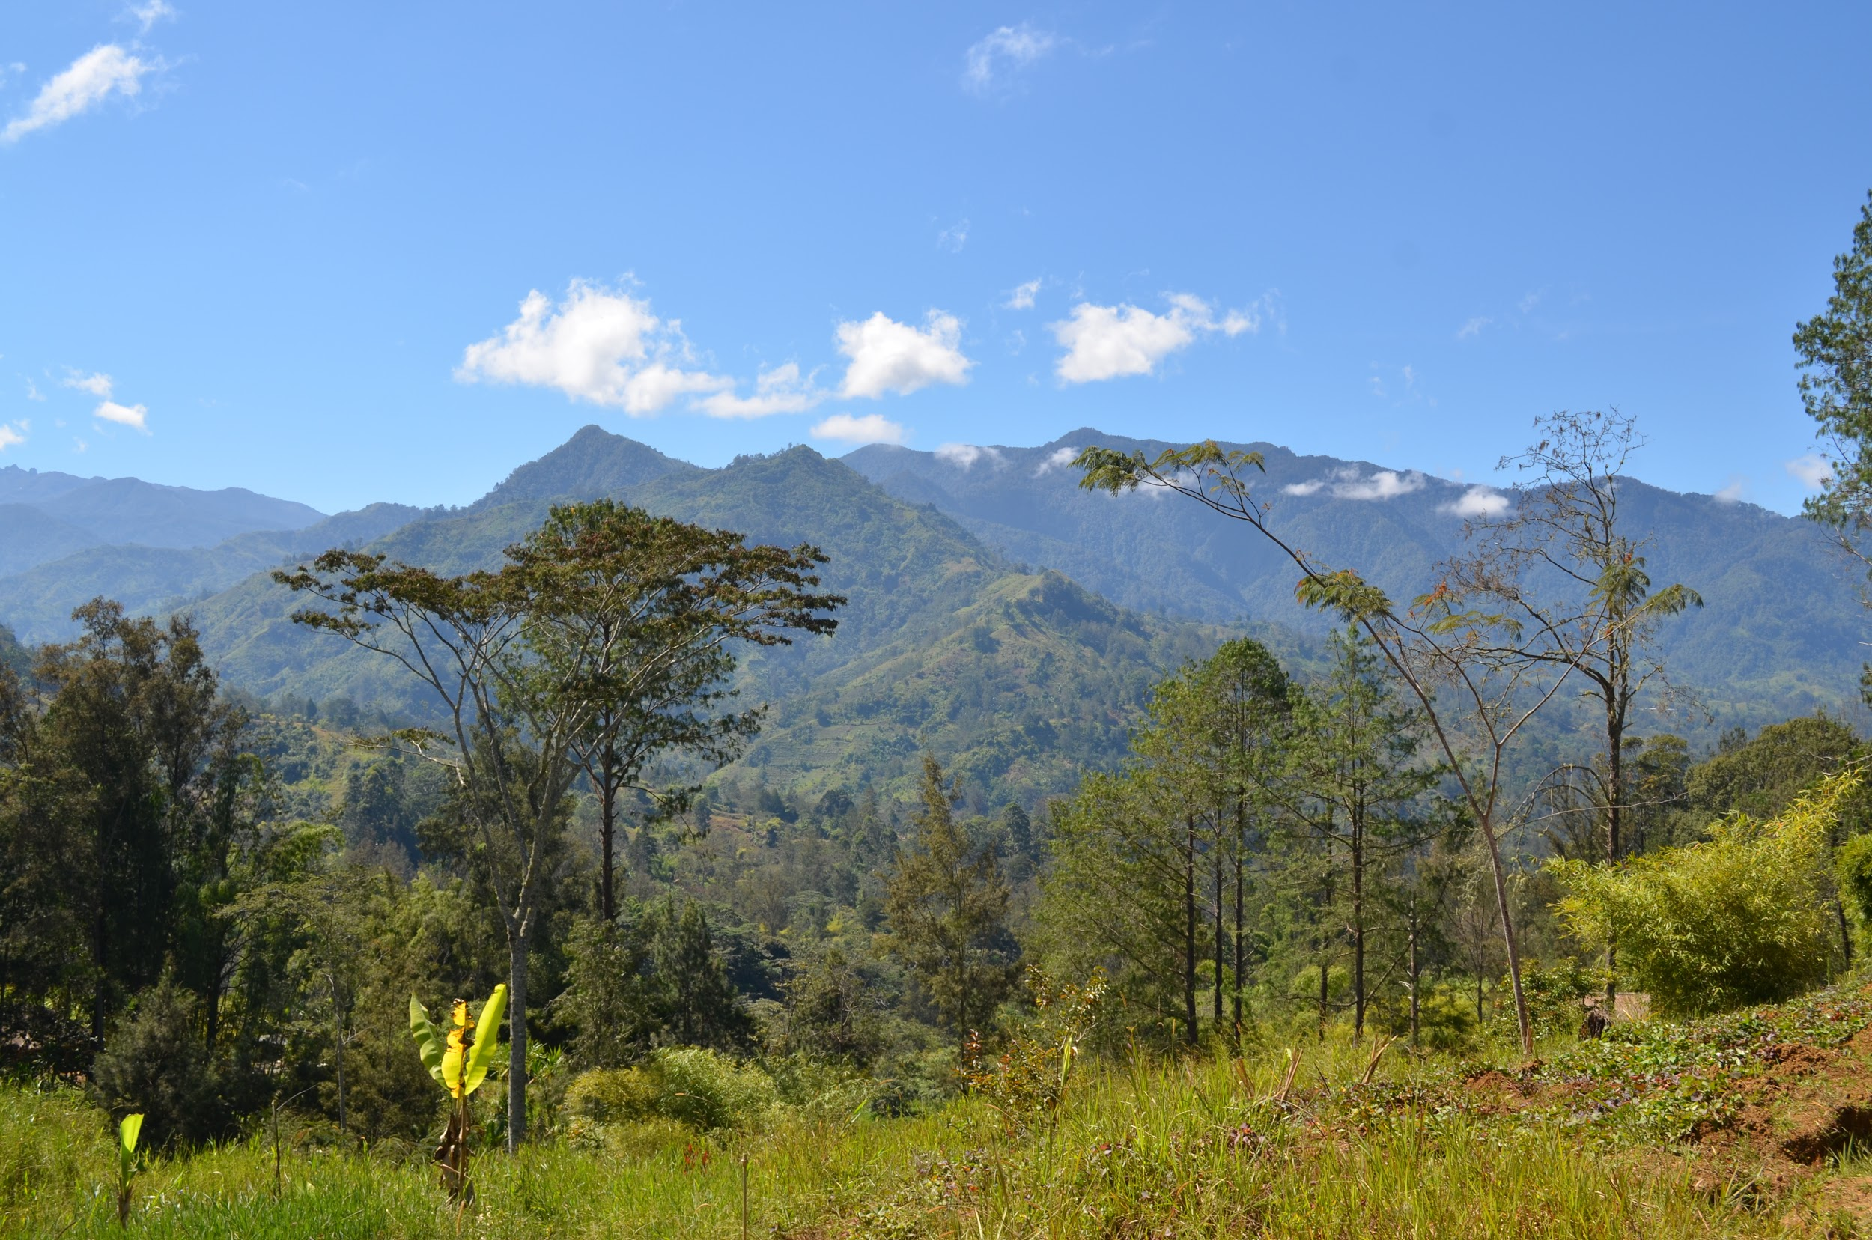
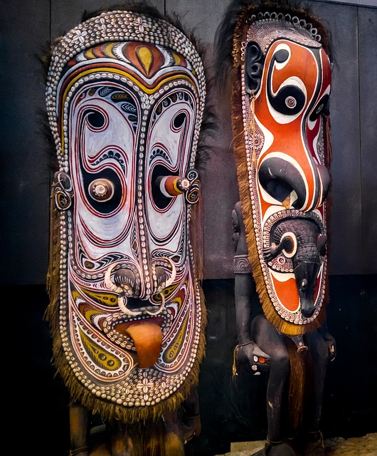
Notes:
New Guinea and masks

Slide 5
What do you notice?
What do you wonder?
What do you think?

Slide 6
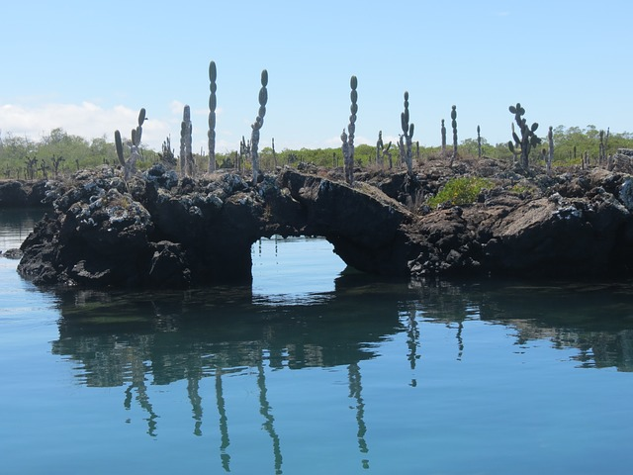
Notes:
Galapagos Islands

Slide 7
What do you notice?
What do you wonder?
What do you think?

Slide 8
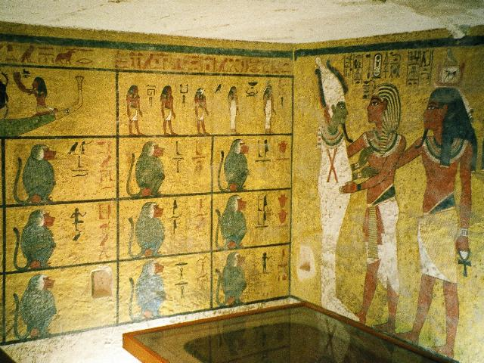
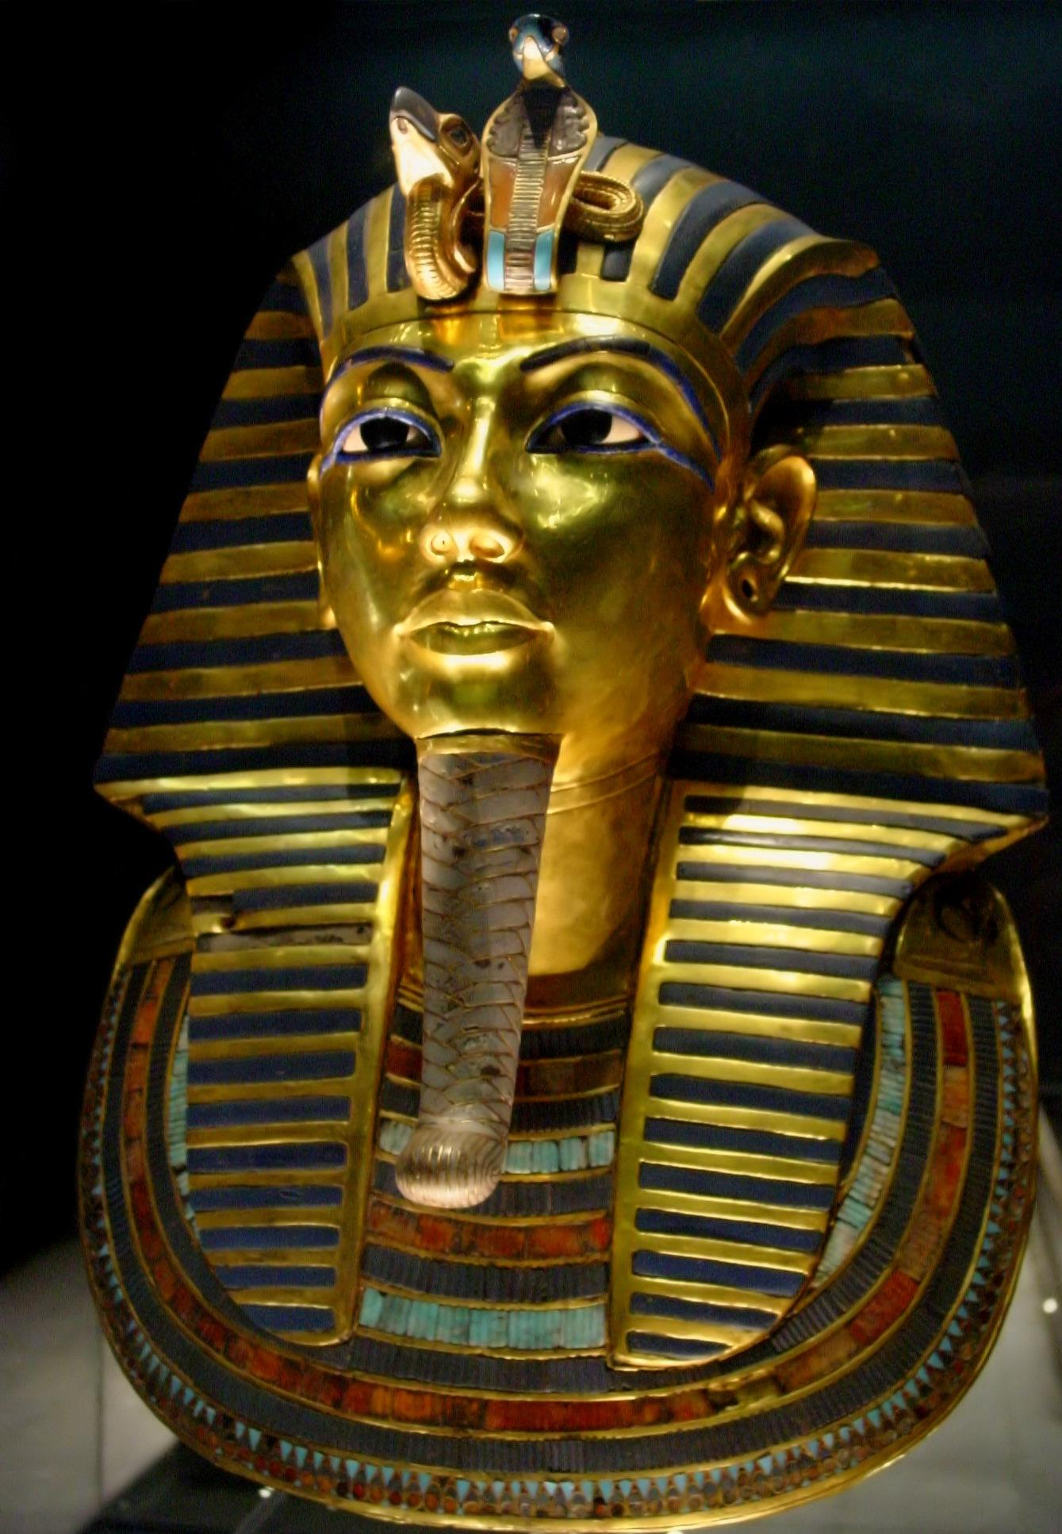
Notes:
King Tut’s tomb, ancient Egypt

Slide 9
What do you notice?
What do you wonder?
What do you think?

Slide 10
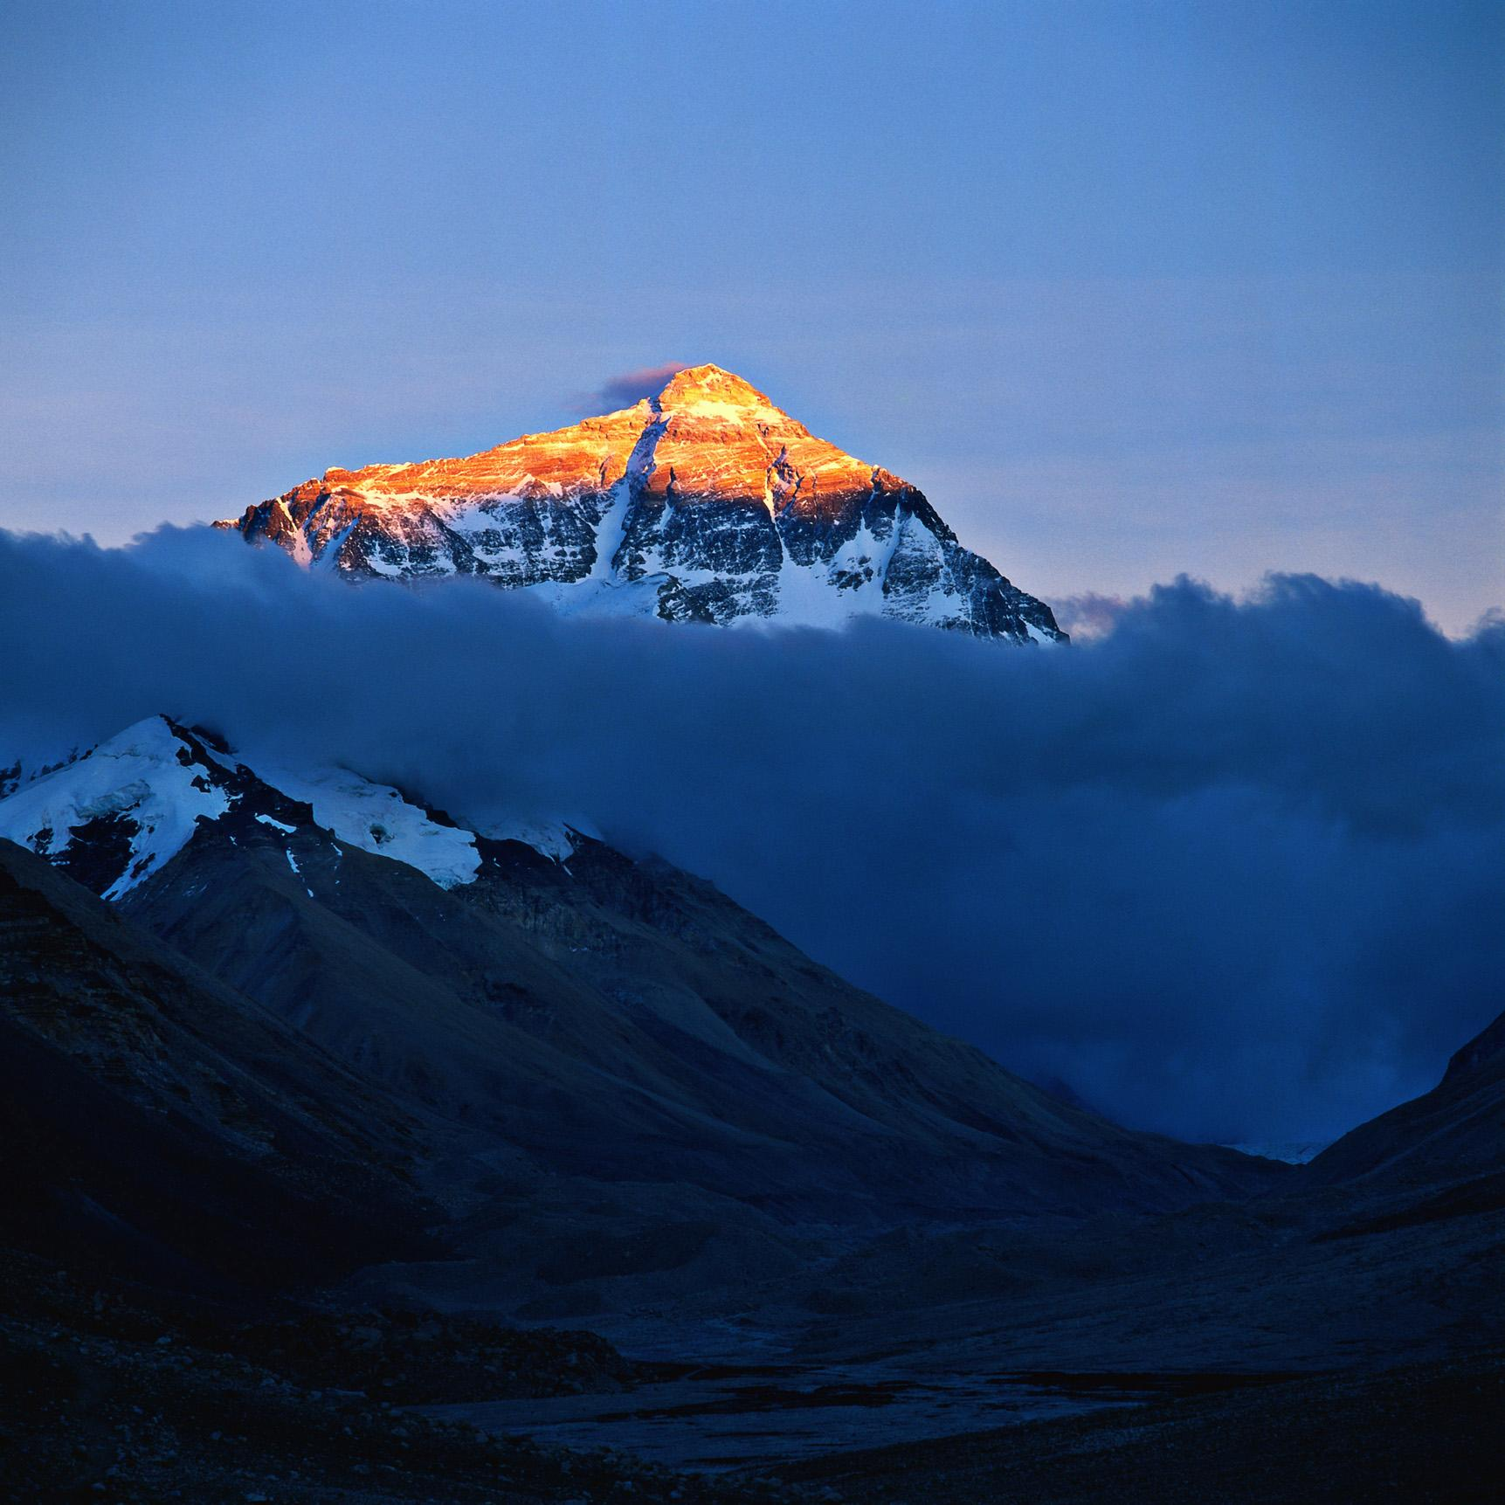
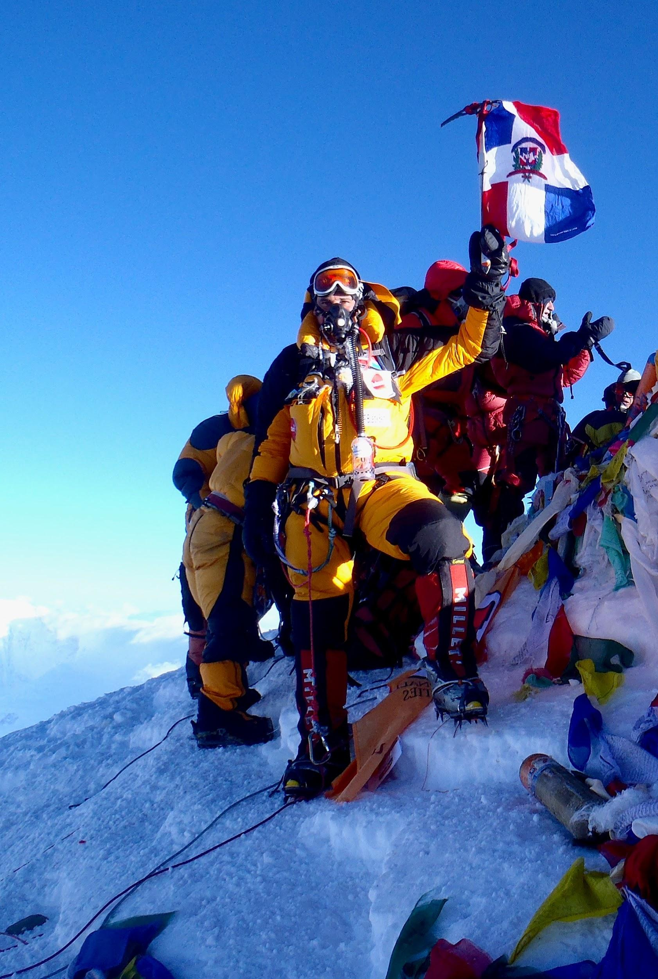
Notes:
mt everest

Slide 11
What do you notice?
What do you wonder?
What do you think?

Slide 12
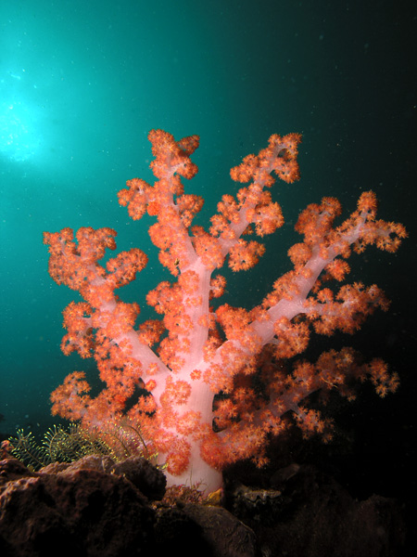
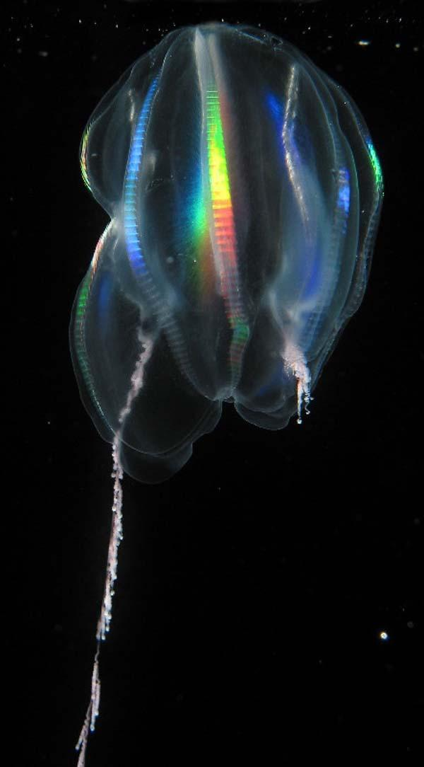
Notes:
deep sea discoveries coral and jelly

Slide 13
What do you notice?
What do you wonder?
What do you think?

Slide 14
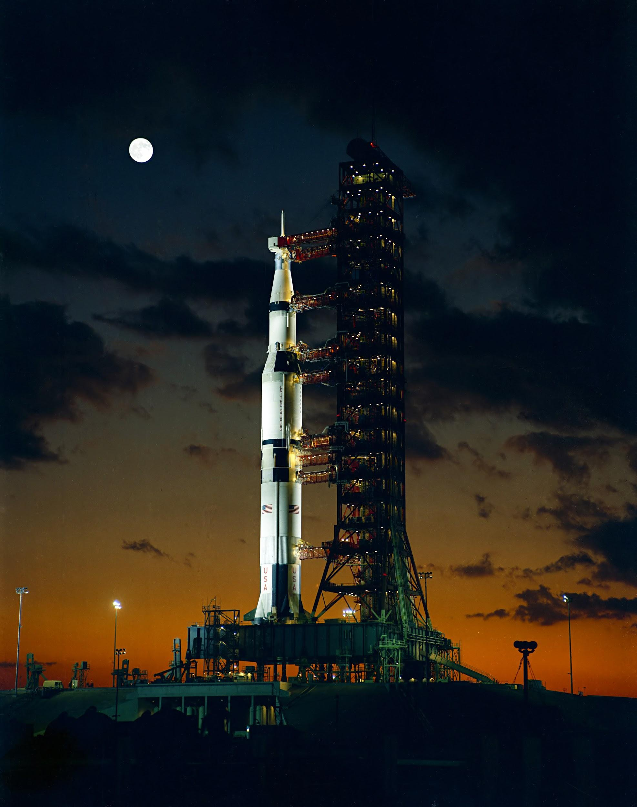
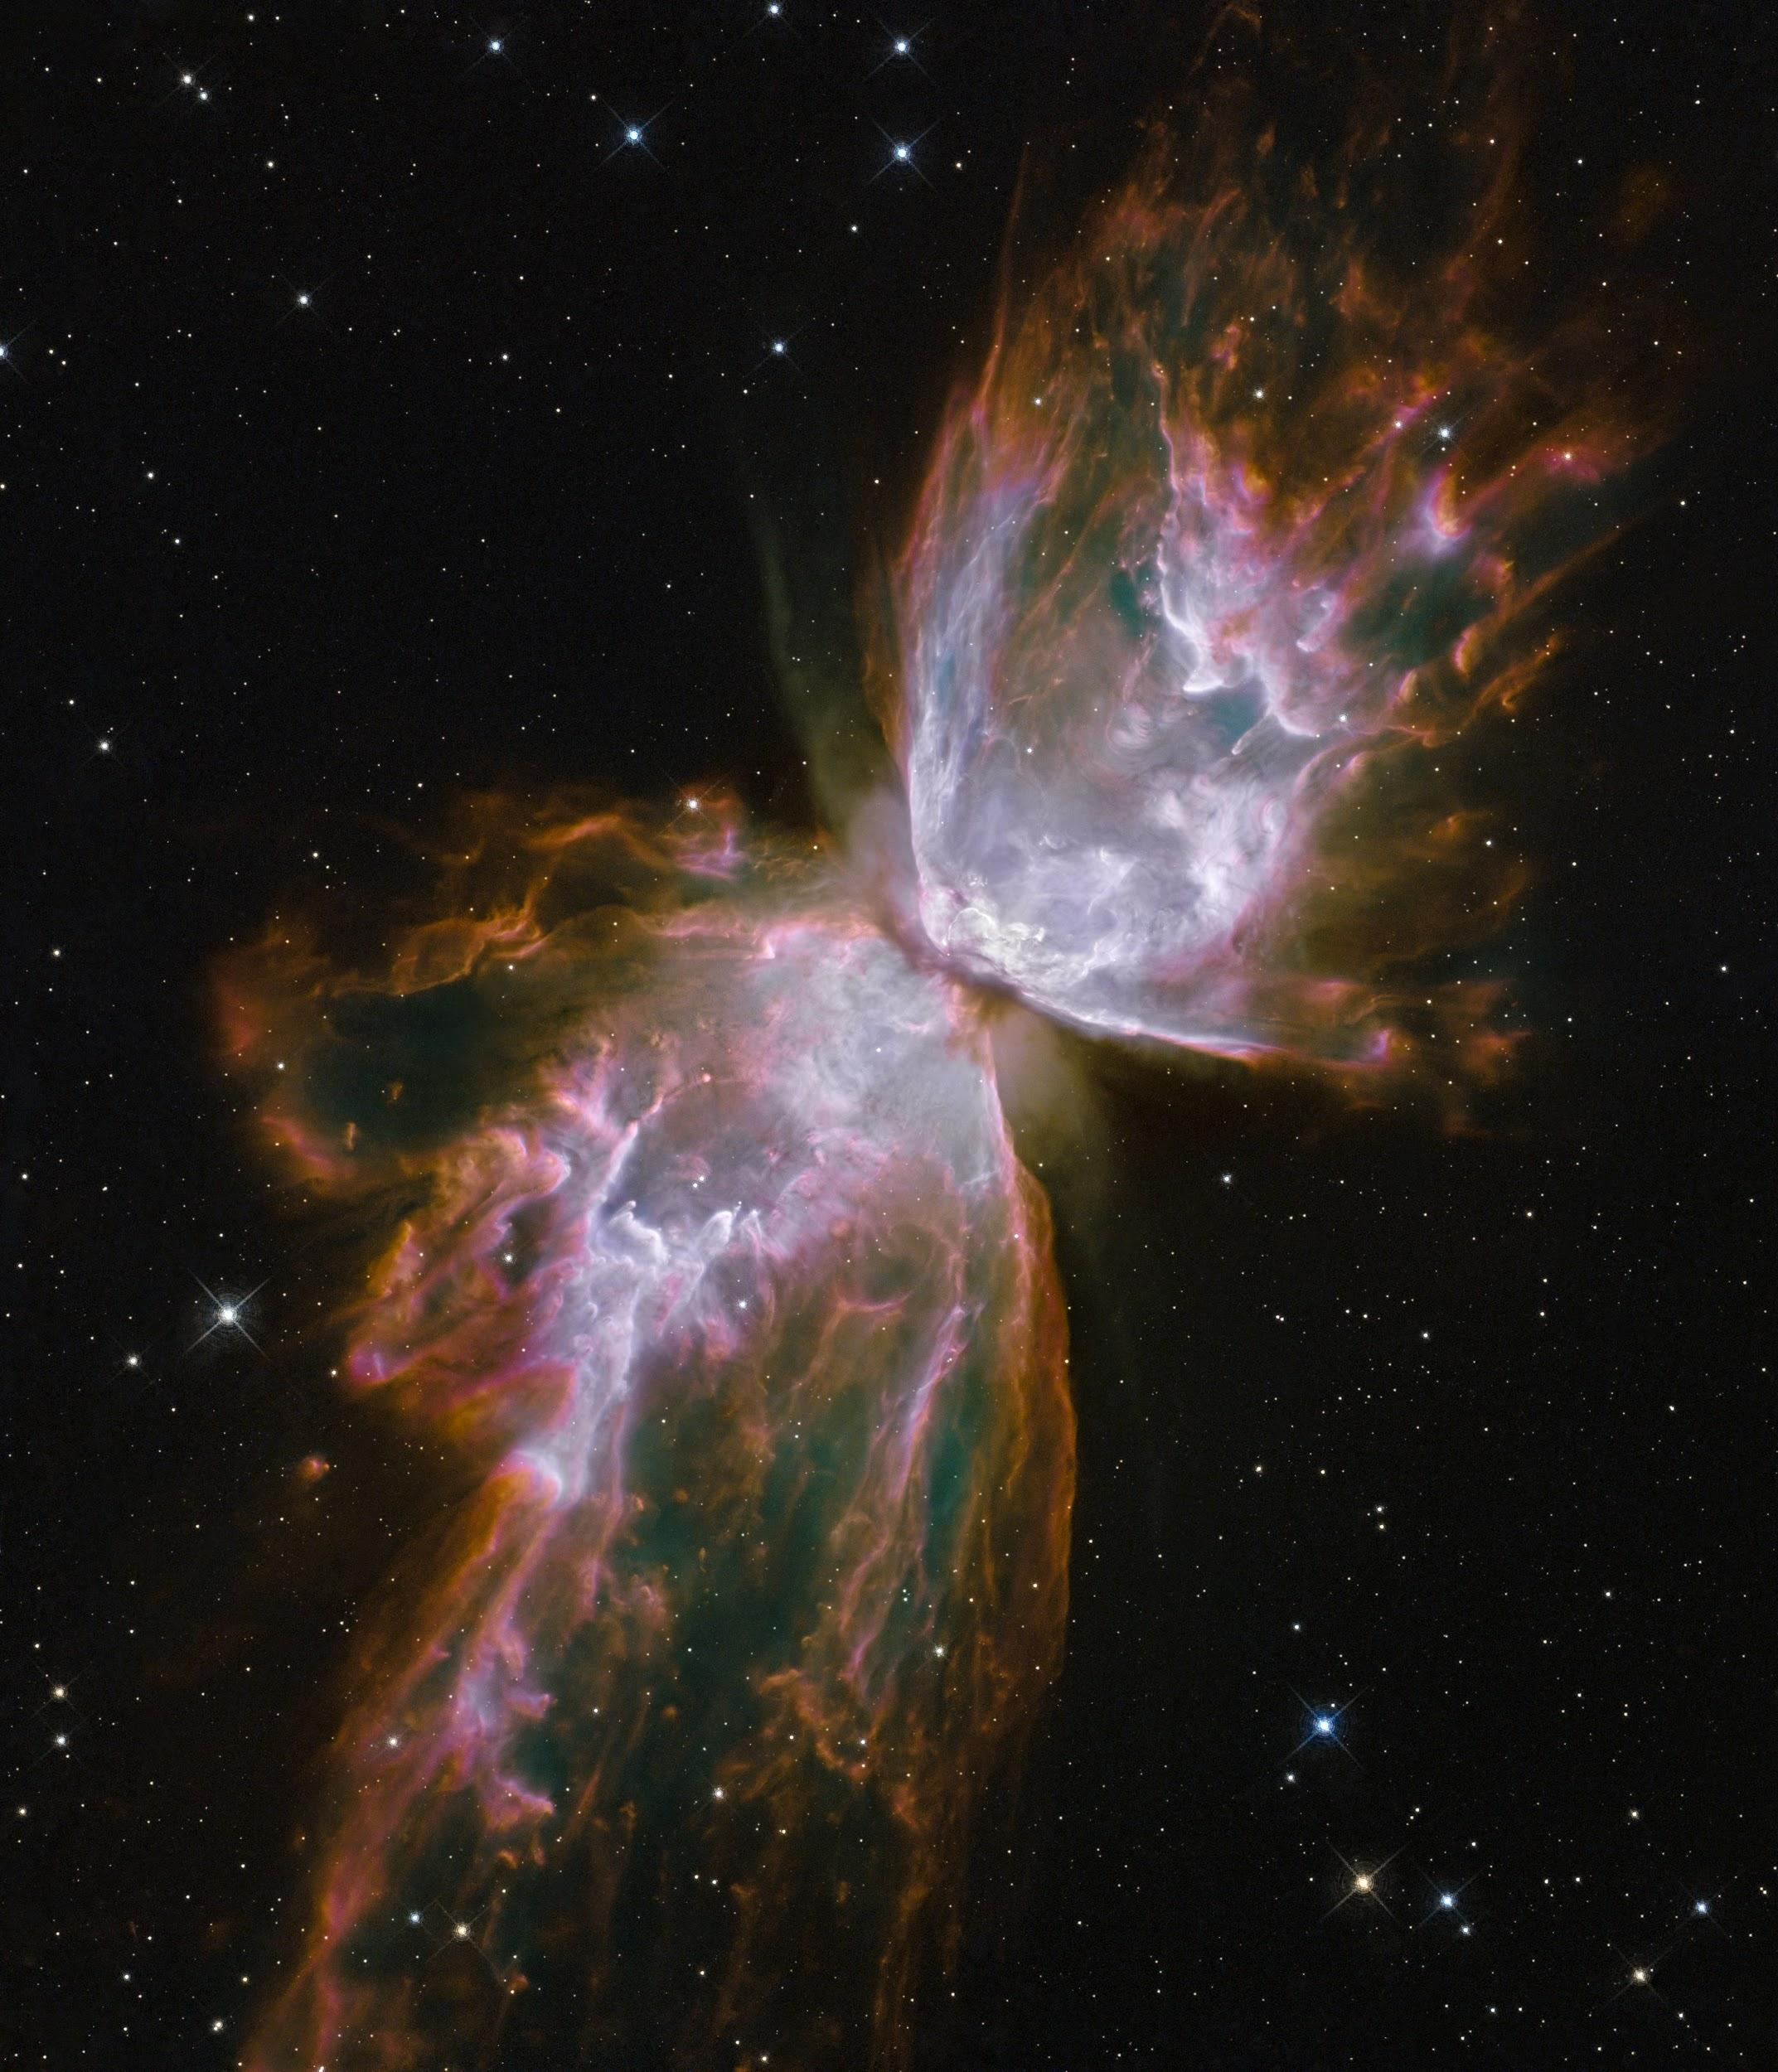
Notes:
space, hubble space telescope image

Slide 15
What do you notice?
What do you wonder?
What do you think?

